Slide 1
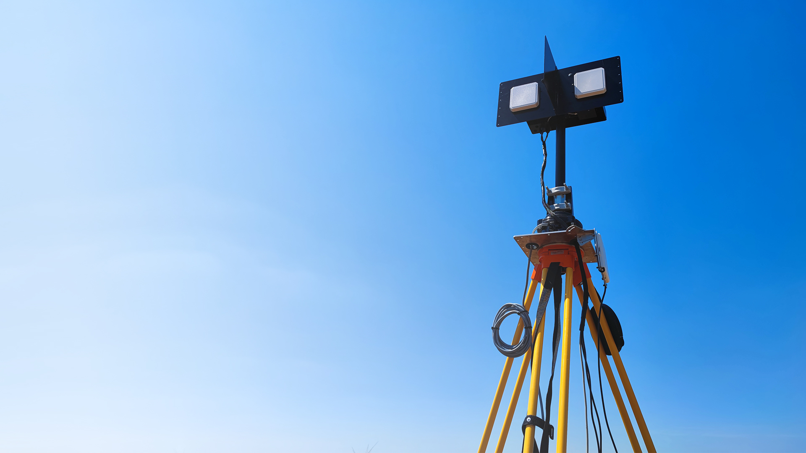
A Novel automated radio-tracking system in biological research
Wohlfart Richárd
Dr. Miklós Ákos
Ifj. Wohlfart Richárd

Slide 2

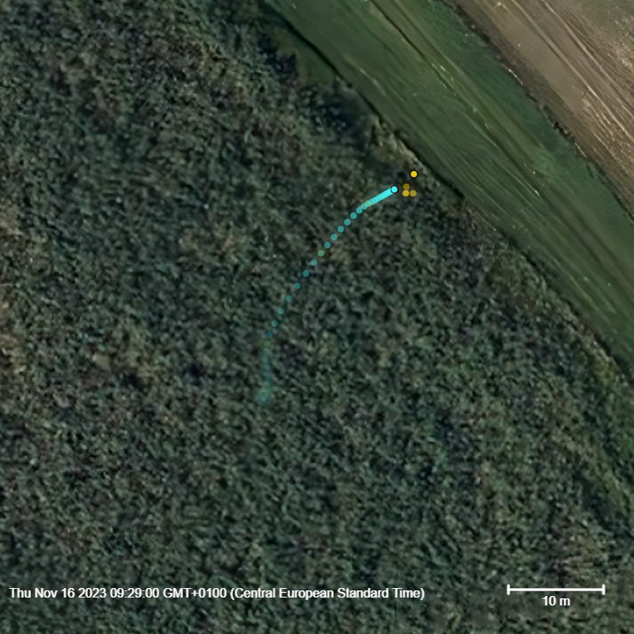
Goals of the Automated System
Precise and frequent location estimates
Fully autonomous operation
Flexibility in potential use cases
Affordability
Habitat Use of a Single Microtus Oeconomus Specimen, 2000x speed (Peter Miklós, PhD. Department of Zoology at Comenius University Bratislava, 2023 Slovakia)
info@telemetry.hu | www.telemetry.hu | Richárd Wohlfart

Slide 3
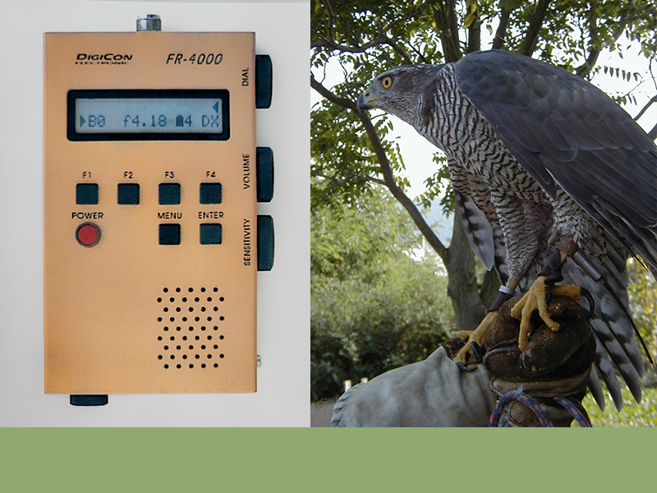
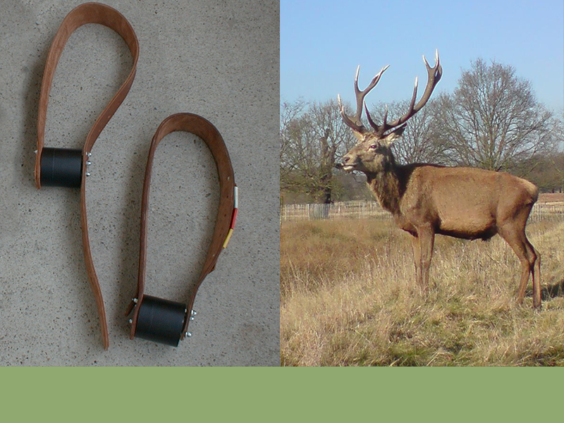
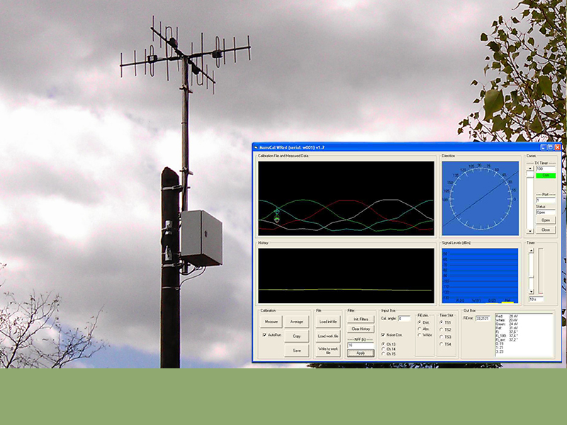
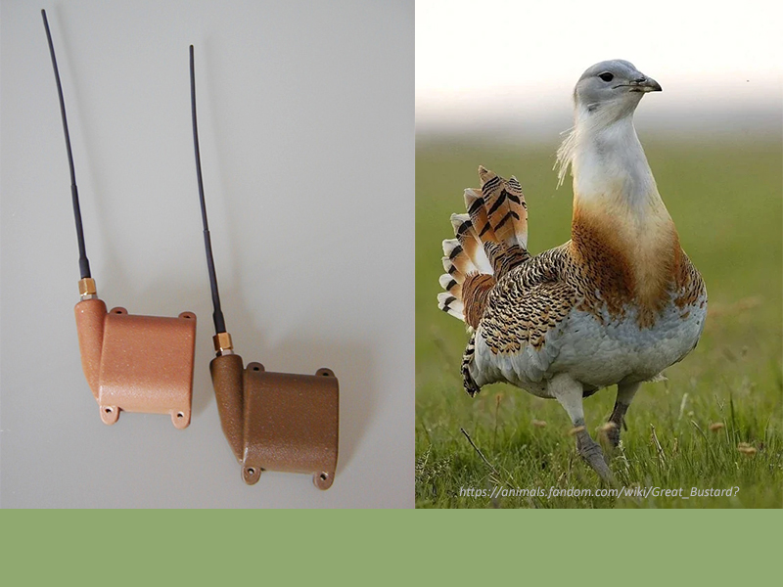
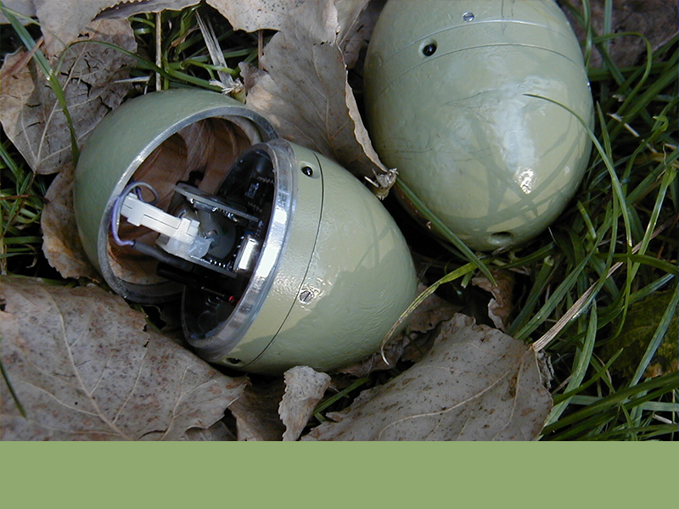
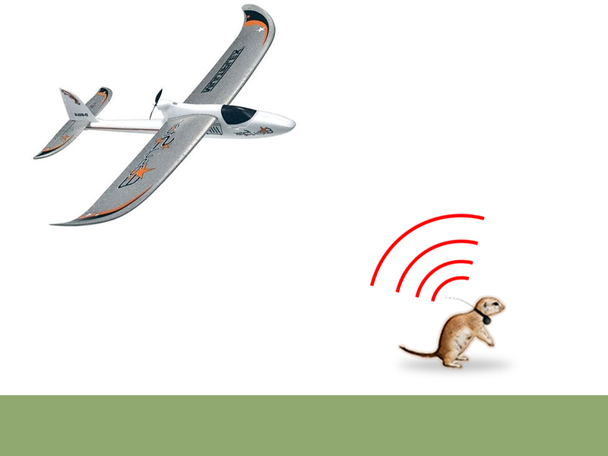
Falconry Receiver
Deer Transmitter
Stationary Angle of Arrival (AOA)
1994
2000
2012
1993
1994
2008
Great Bustard (Otis Tarda) Transmitters
Data Logging Fake Great Bustard Eggs
RC Airplane-Based Data Collection
info@telemetry.hu | www.telemetry.hu | Wohlfart Richárd

Slide 4
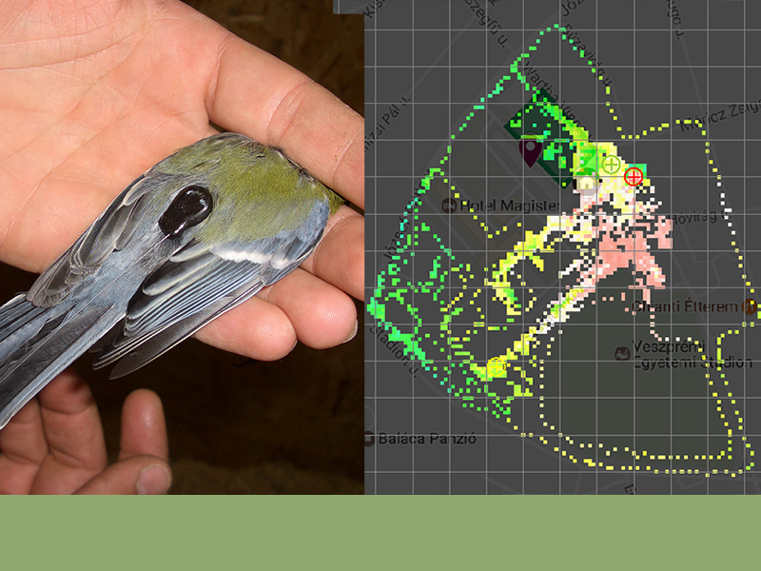
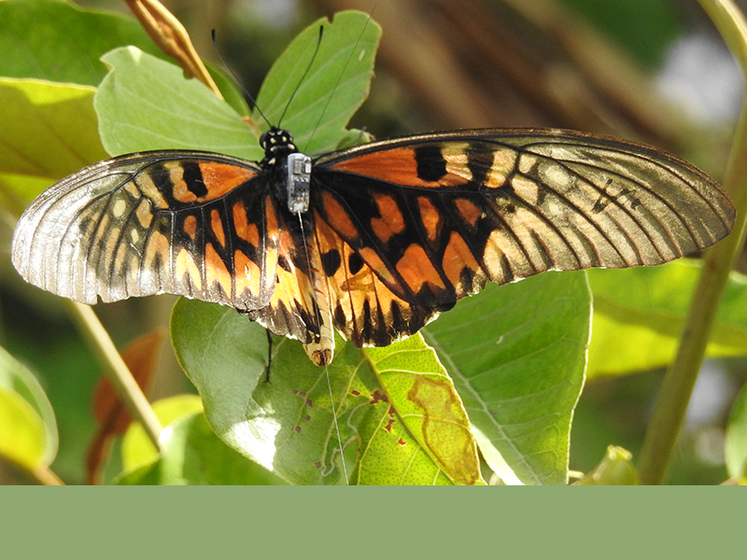
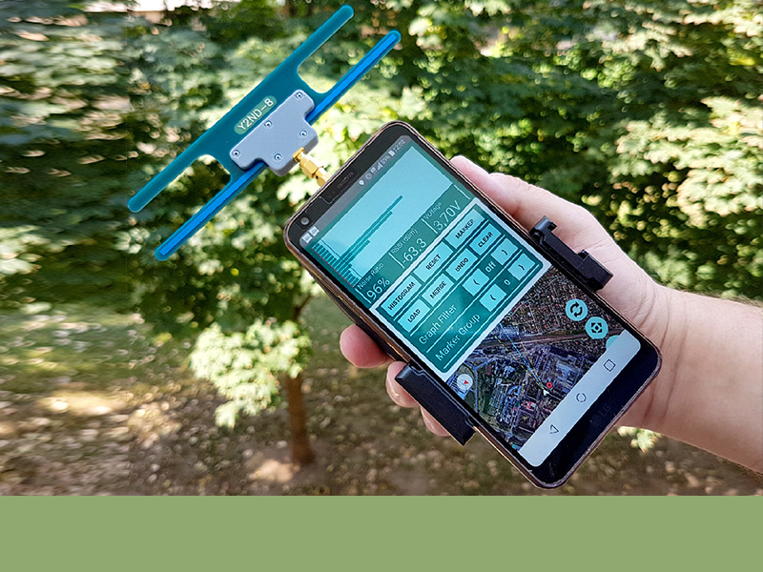
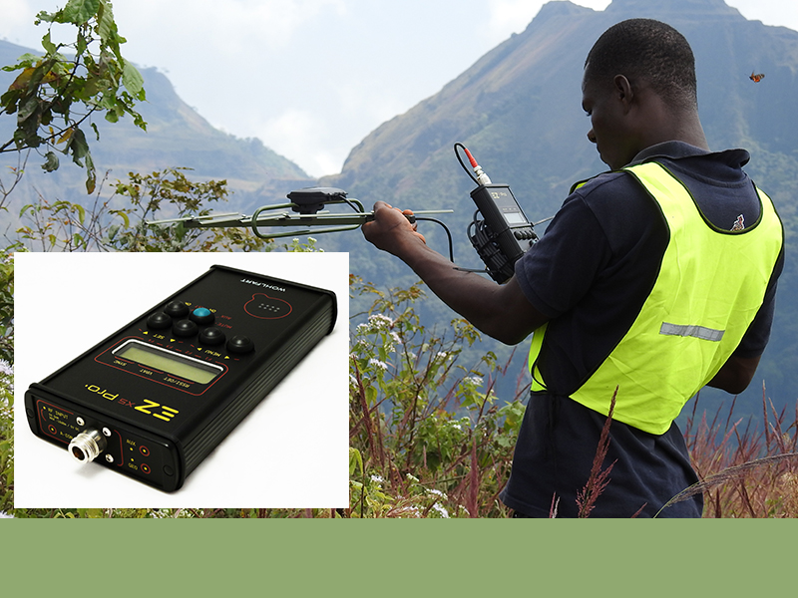
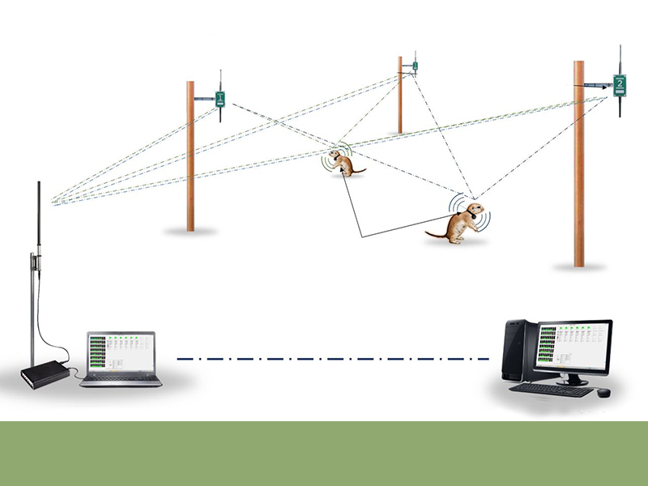
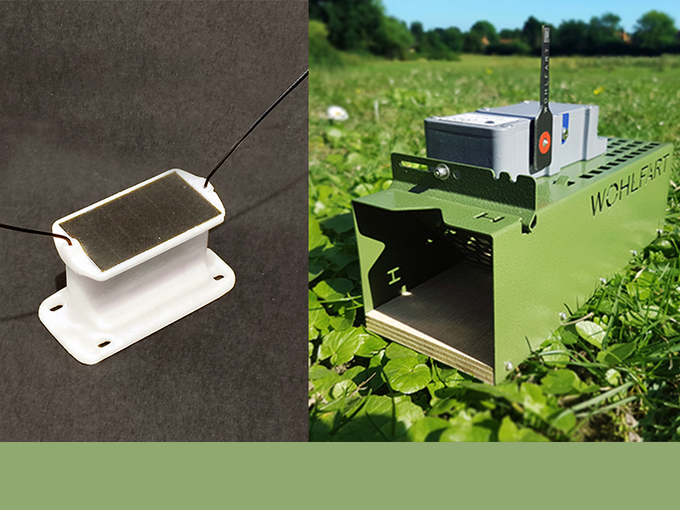
Great Tit, Fingerprinting Tracking Method
Liberia, African Giant Swallowtail
Advanced Smartphone-based Receiver
2016
2017
2020
2015
2016
2018
African Giant Swallowtail Reserach
Automated Fingerprinting System
LoRa-based GPS Tag and Trap
info@telemetry.hu | www.telemetry.hu | Wohlfart Richárd

Slide 5
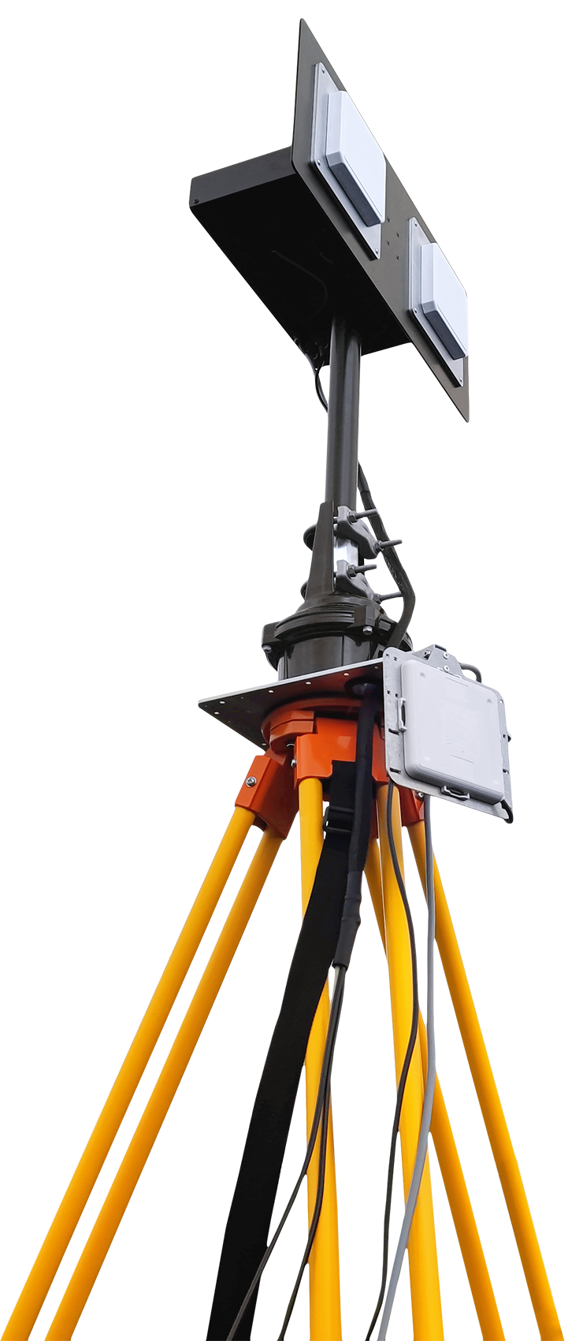
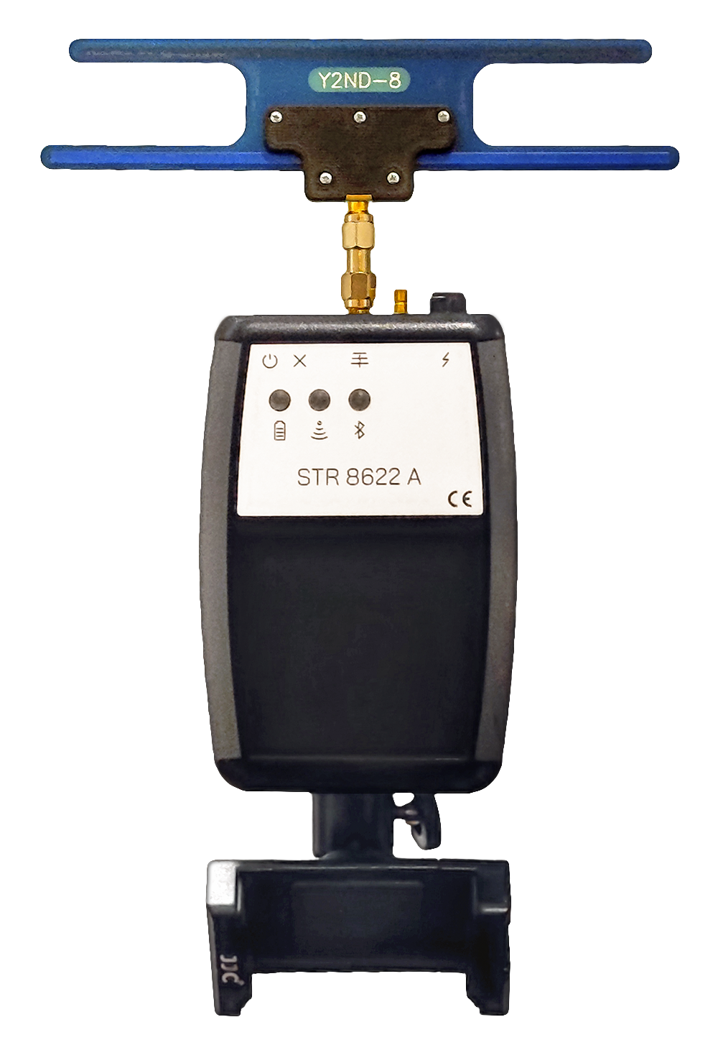
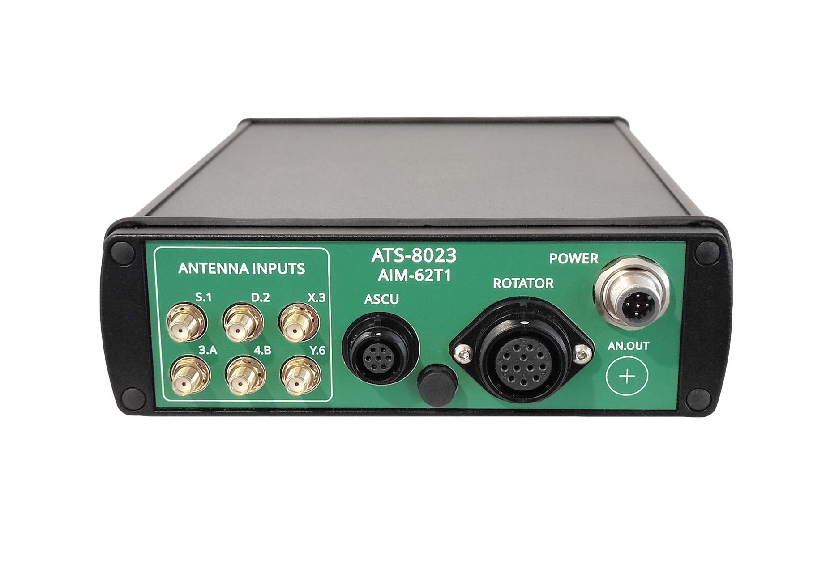
Automated Radio-Tracking System
Supports multiple measurement strategies: stationary AOA, rotating AOA, Fingerprinting
Intelligent transmitters: accurate clock, microprocessor, sensors and data transfer capability, variable modes of operation
Remote controllable transmitters => 10-15 gram animals can be monitored for years
Longer range than other manufacturers
Designed for animals with small to medium home ranges
Small animals such as: small mammals, reptiles, birds, insects
Research area optimally between 0.2 and 1000 hectares
Years of autonomous operation
Quick to set up, single day study possible
Interoperability with our handheld receivers
info@telemetry.hu | www.telemetry.hu | Richárd Wohlfart

Slide 6
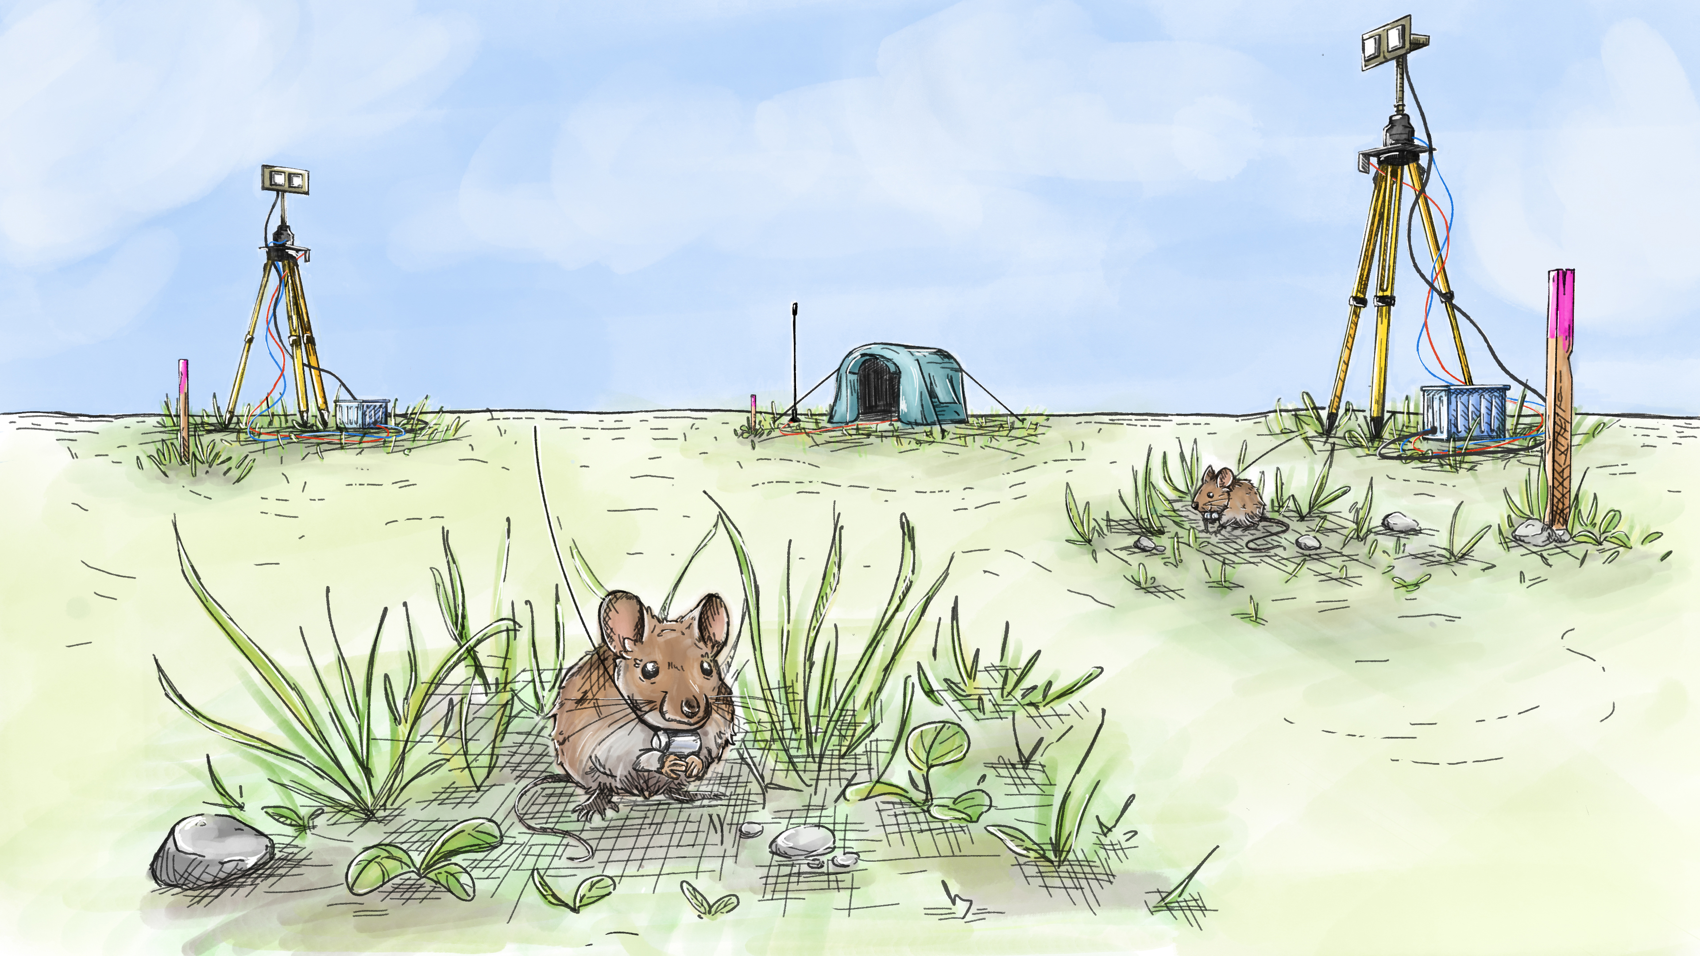
info@telemetry.hu | www.telemetry.hu | Wohlfart Richárd

Slide 7
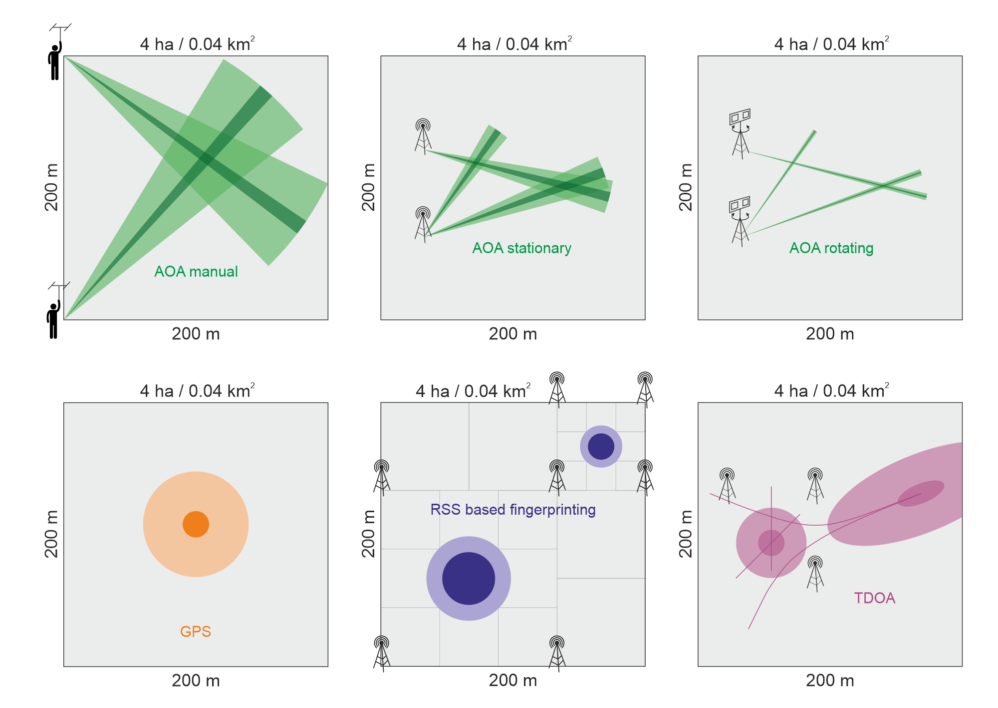
info@telemetry.hu | www.telemetry.hu | Wohlfart Richárd

Slide 8
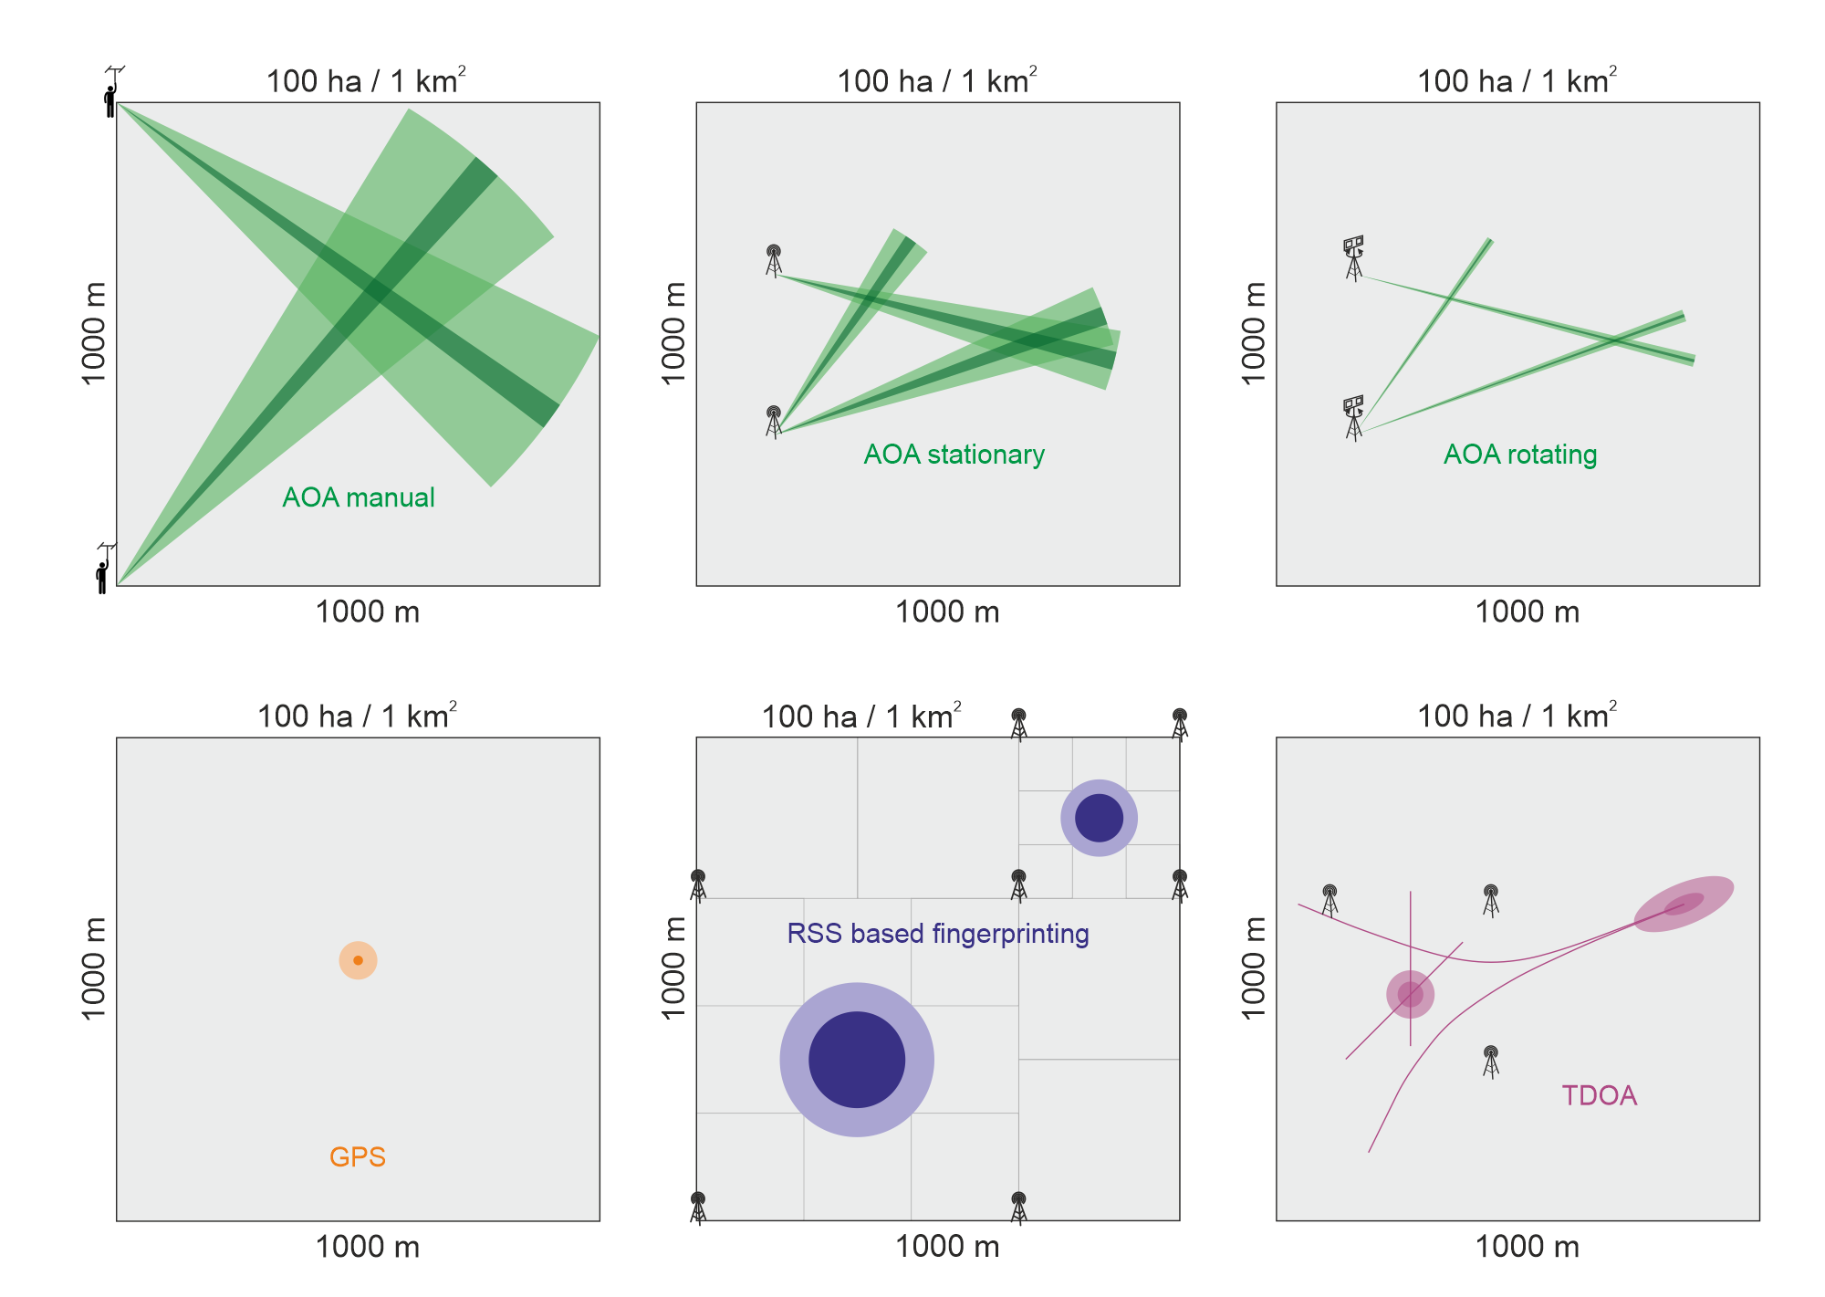
info@telemetry.hu | www.telemetry.hu | Wohlfart Richárd

Slide 9
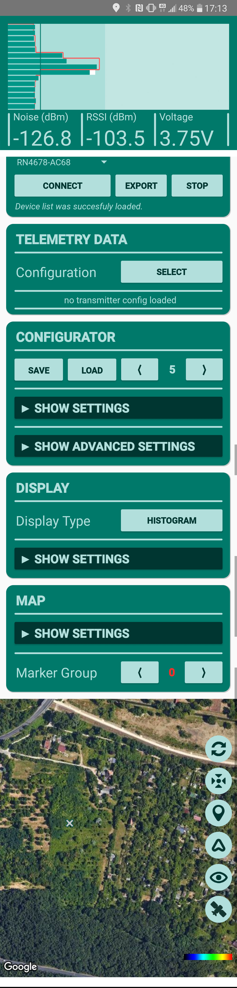
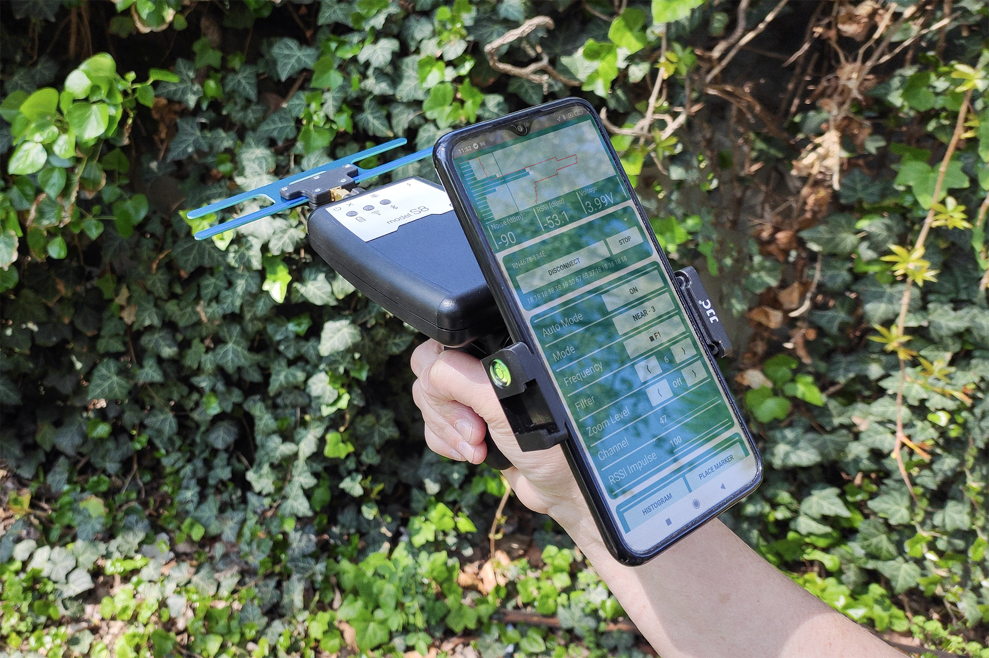
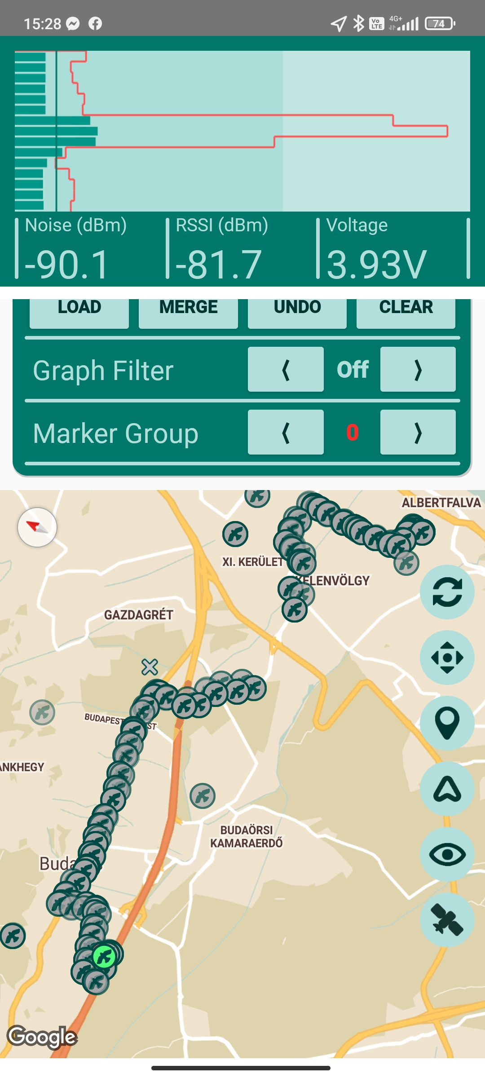
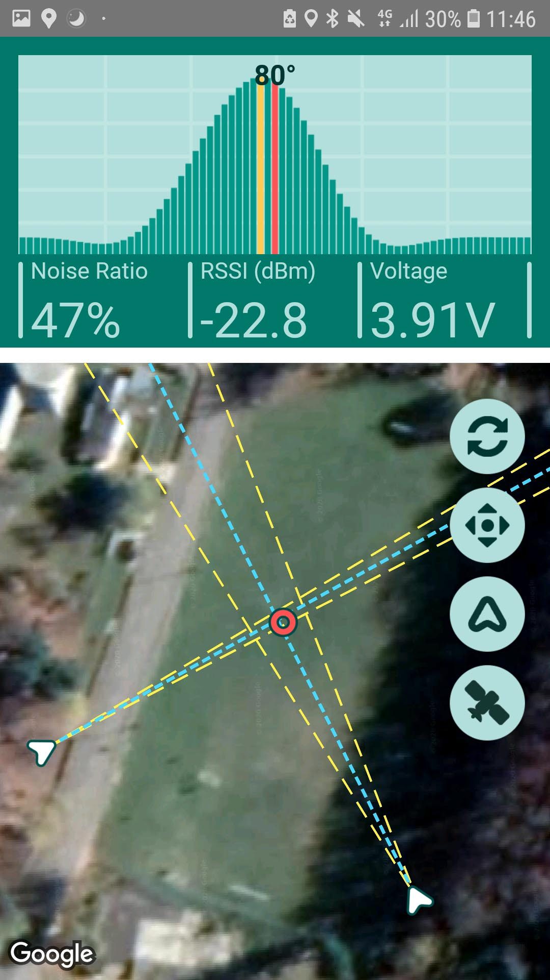
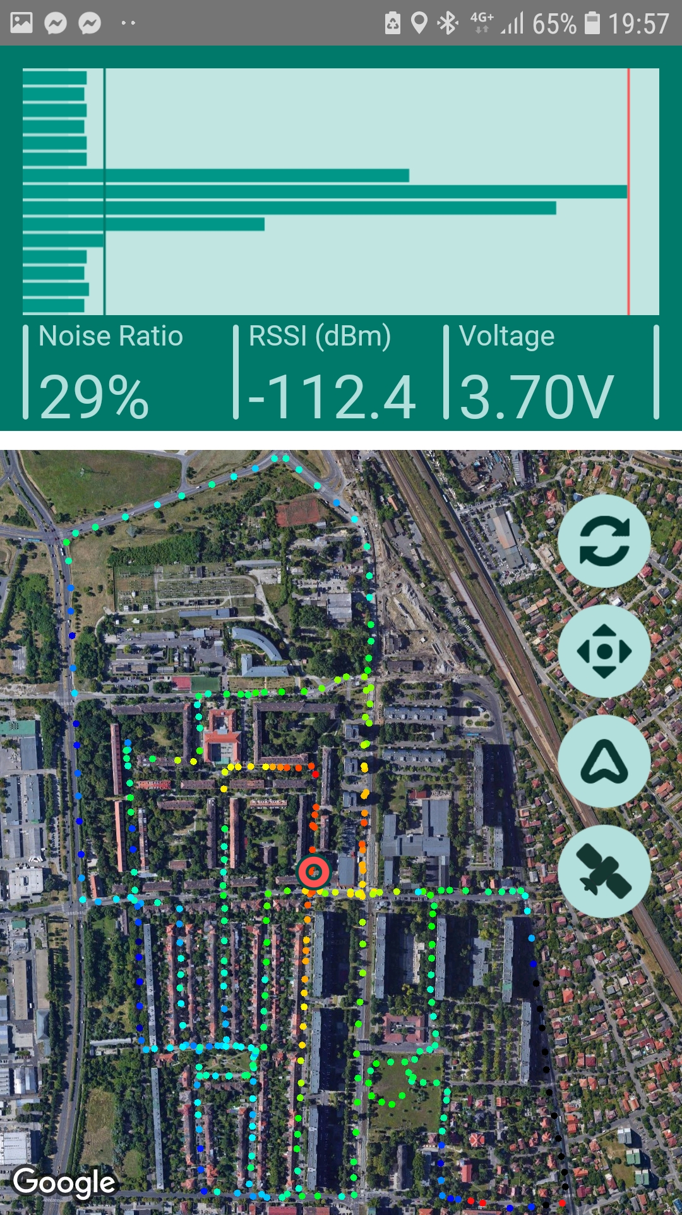
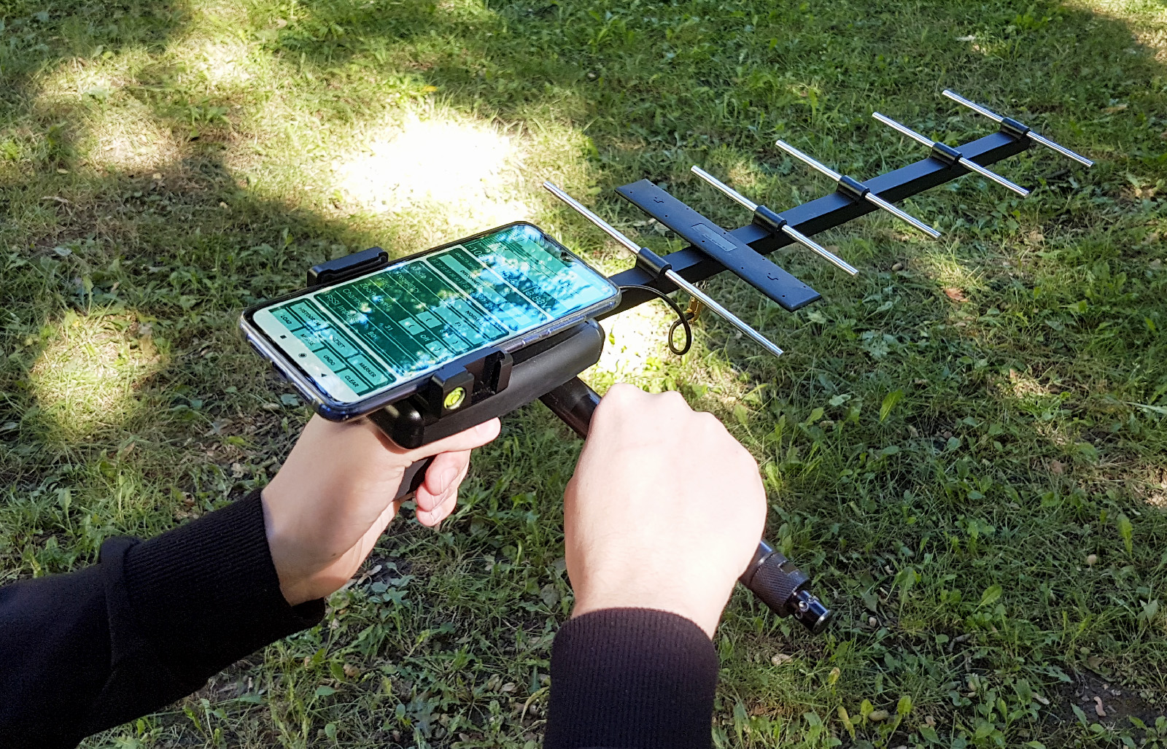
Handheld Receivers
Traditional receiver combined with modern solutions => Smartphone support
Modes of operation: Traditional, Semi-autonomous, heatmap-based
Multiple graph types, integrated map
Display GPS transmitter data
Logs all received signal data into files
Can be used with PC processing software => Simultanious monitoring of up to 30-40 animals
info@telemetry.hu | www.telemetry.hu | Wohlfart Richárd

Slide 10
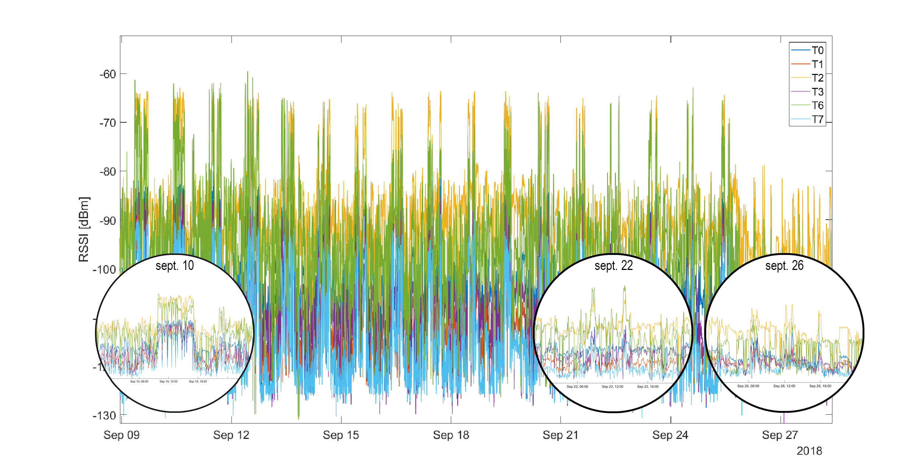
info@telemetry.hu | www.telemetry.hu | Wohlfart Richárd

Slide 11
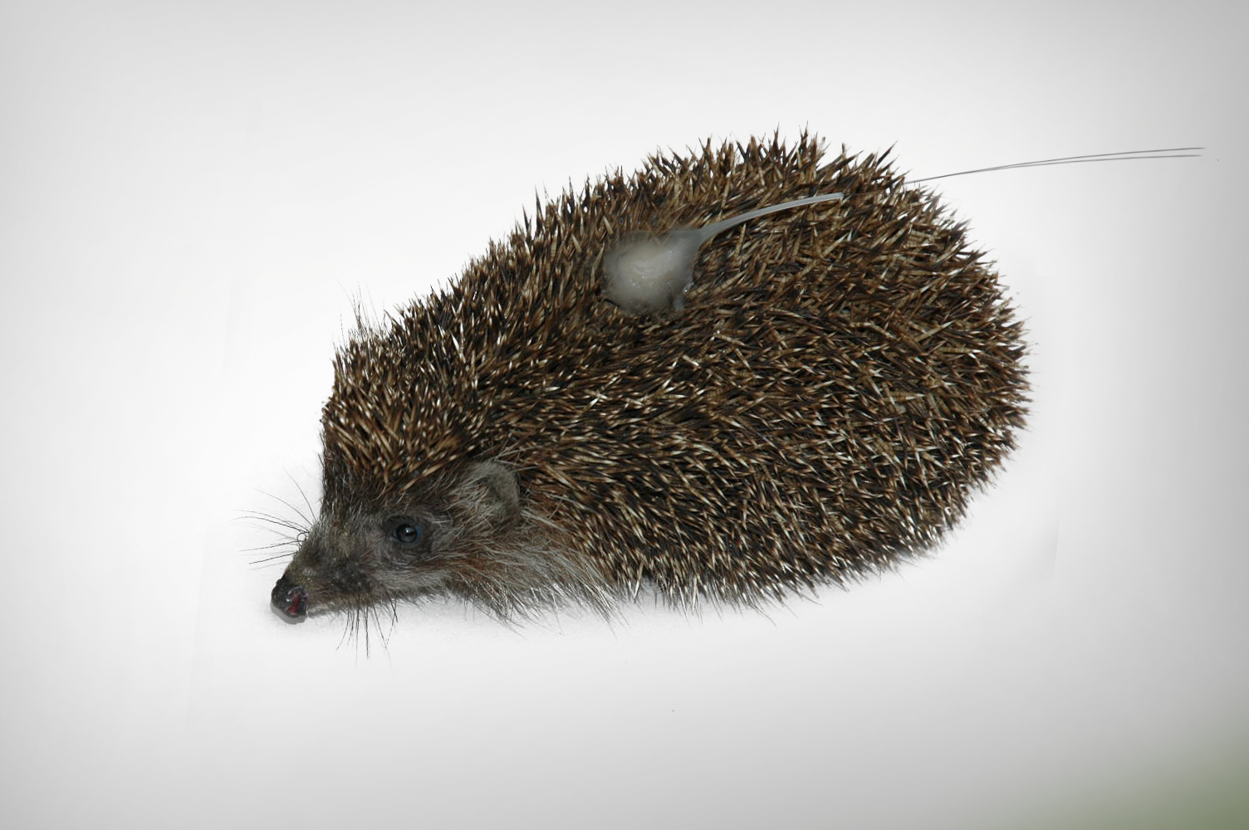
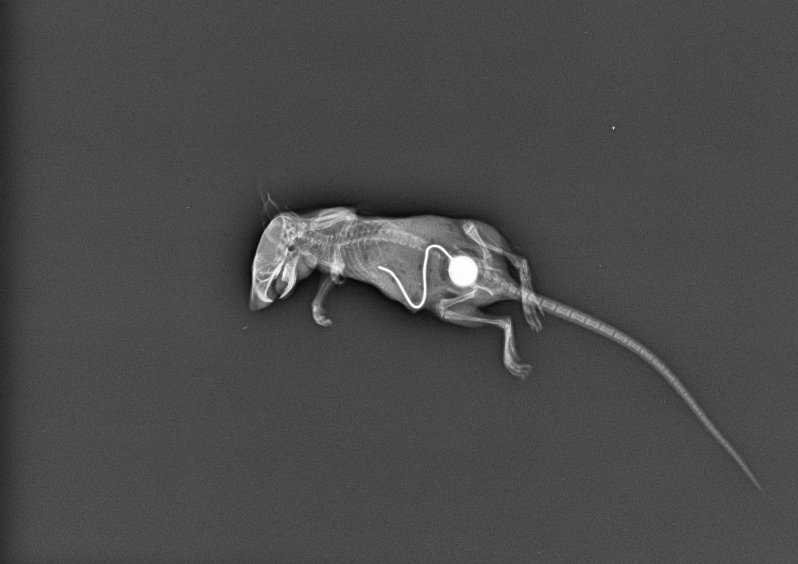
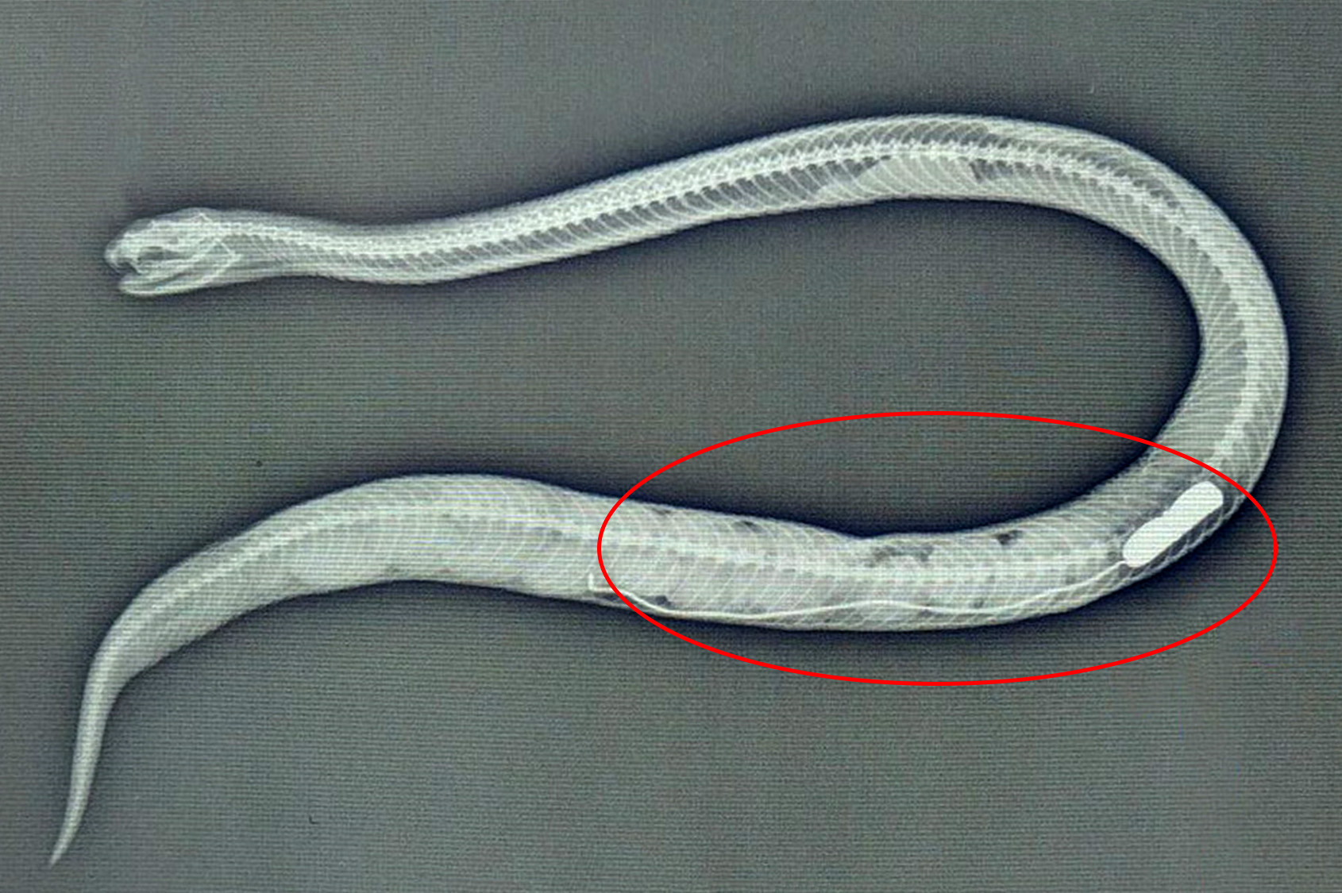
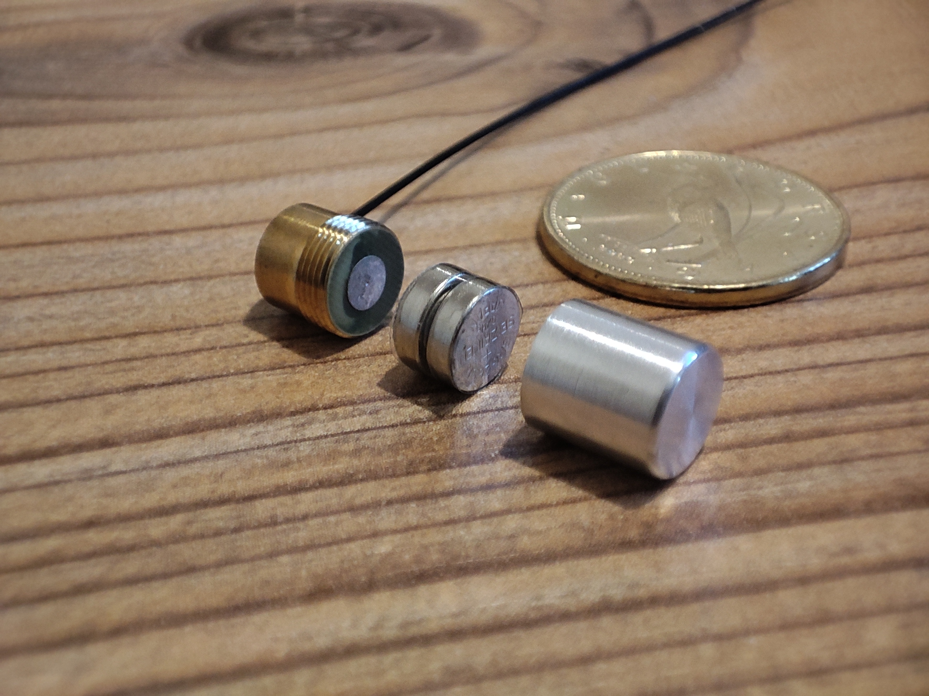
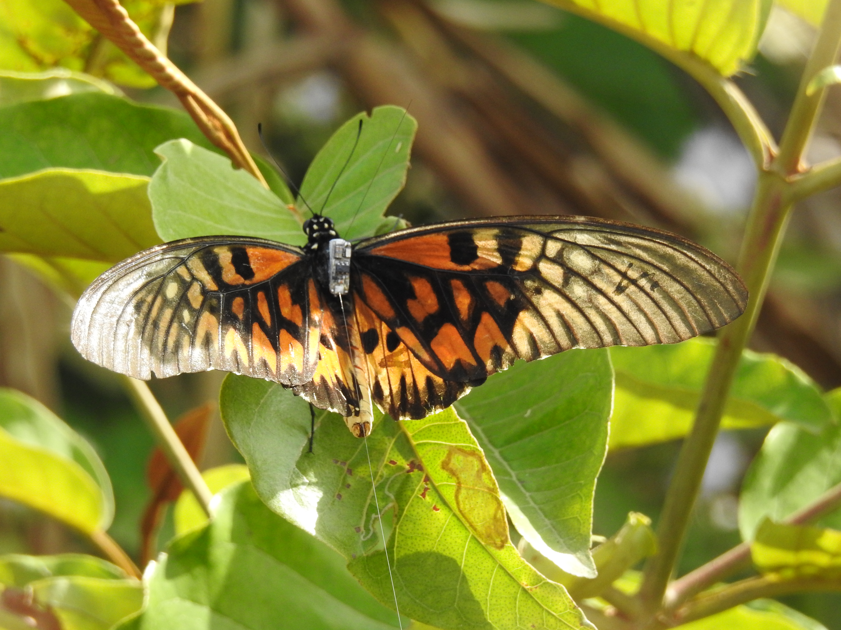
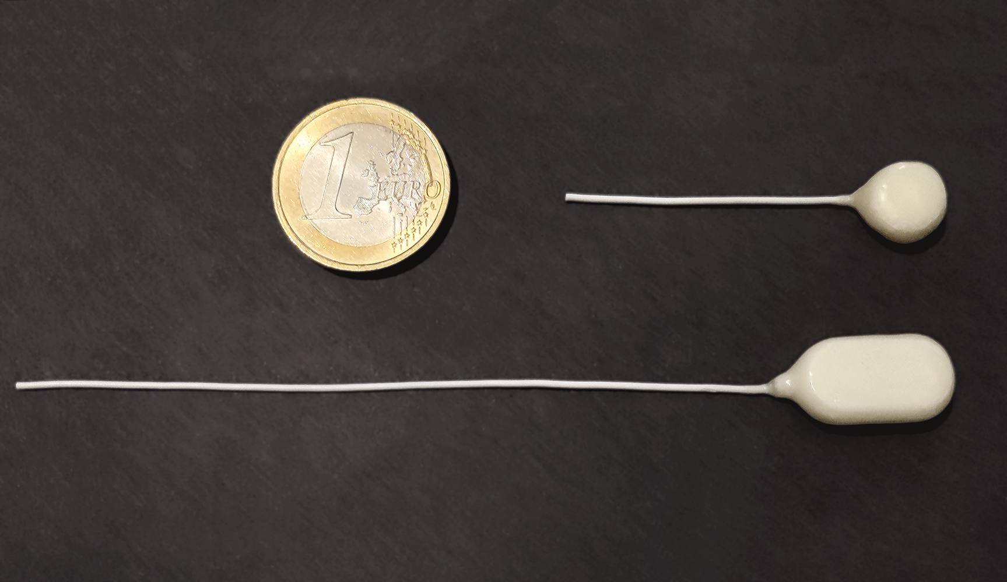
Transmitters / Radio Tags
Unique transmitter technology => multiple devices on the same frequency
Significantly longer range than other manufacturers
The transmitters can weigh as little as 0.2 grams
Can have replacable batteries => reusability
Implantable transmitters, antenna made of soft material
Built-in sensors => temperature, (IR) light, battery voltage, proximity => Data transfer capability
info@telemetry.hu | www.telemetry.hu | Wohlfart Richárd

Slide 12
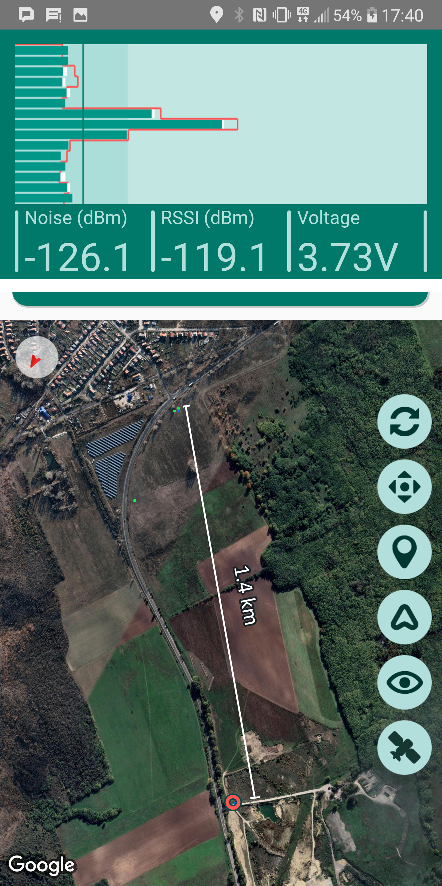
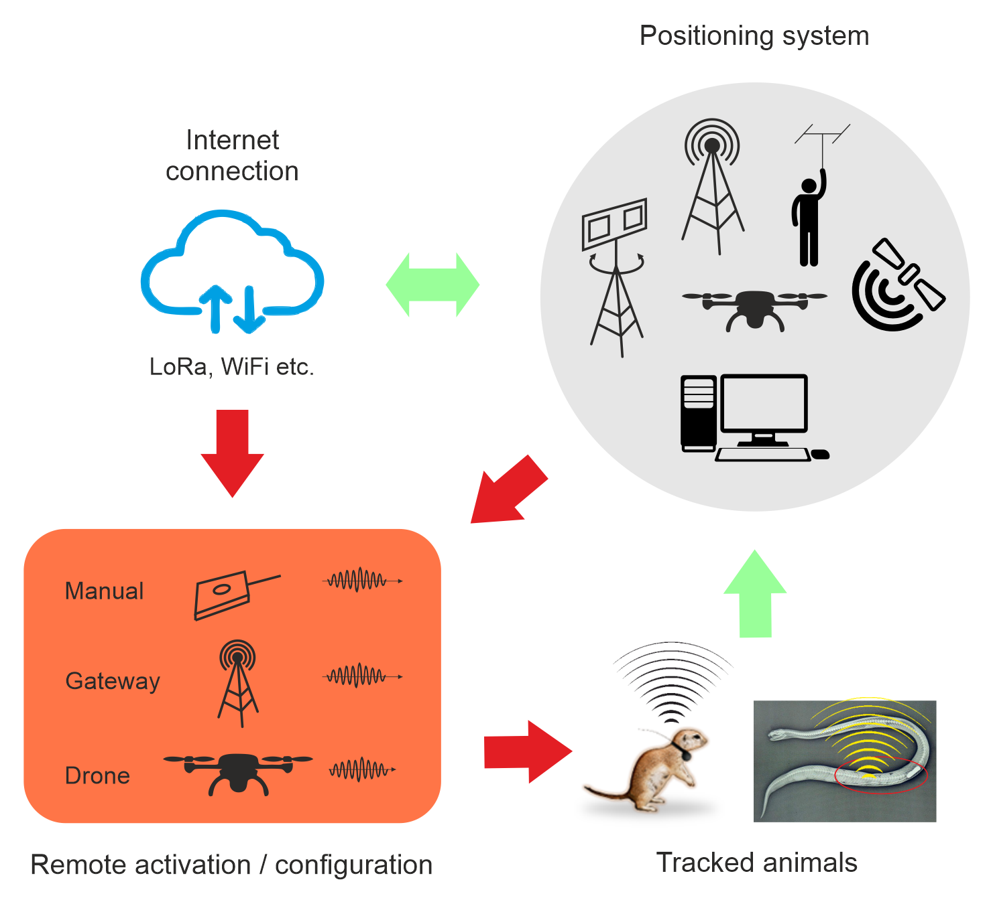
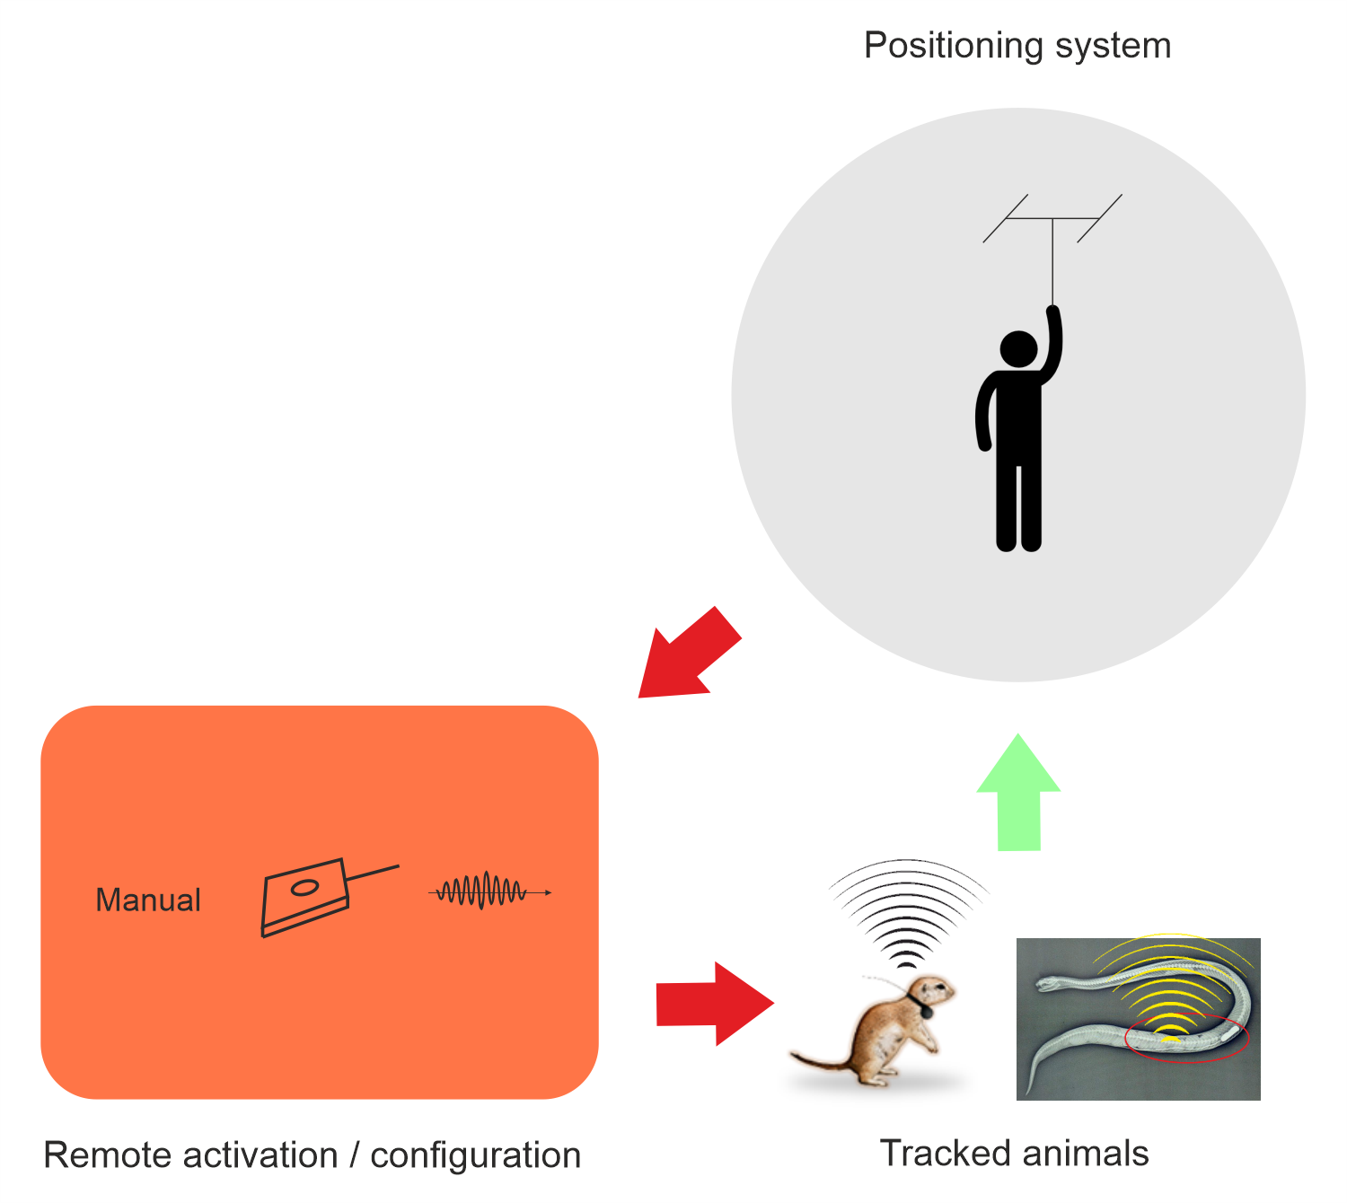
Transmitter Remote Control
Remote controllable: Can be turned on and off, can be reconfigured
Remote control => extremely long stand-by time, up to 8 years for 15-20 gram animals
4 years of operating time, if 50% of energy is used for transmissions, with a 1 gram transmitter.
Completely new ways to conduct research: observe the migration of small animals over long time periods
info@telemetry.hu | www.telemetry.hu | Wohlfart Richárd

Slide 13
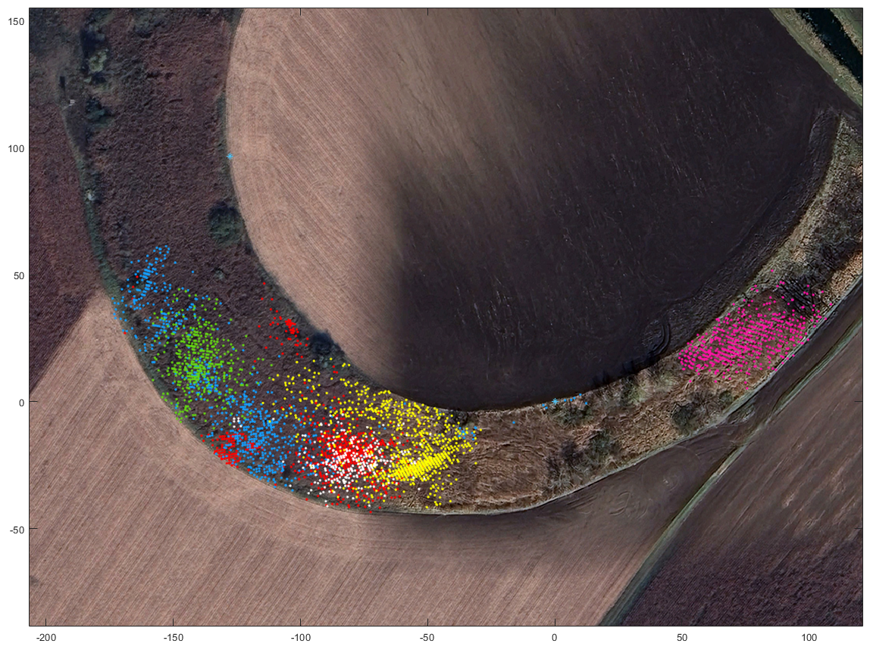
Visualization of the Habitat Use of 6 Microtus Oeconomus (Filip Tulis, PhD.’s Research Group in 2023, Department of Environmental Sciences, Constantine the Philosopher University, Slovakia)
info@telemetry.hu | www.telemetry.hu | Wohlfart Richárd

Slide 14
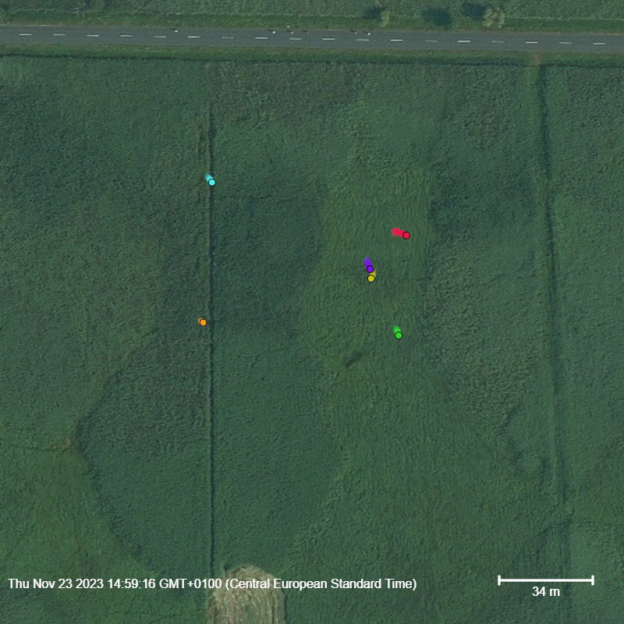
Movements of 6 Microtus Oeconomus Specimens, 4000x speed (Dr. Horváth Győző, Department of Ecology at University of Pécs; Filip Tulis, PhD.’s Research Group in 2023, Department of Environmental Sciences, Constantine the Philosopher University ; Kis-Balaton, Hungary)
info@telemetry.hu | www.telemetry.hu | Wohlfart Richárd

Slide 15
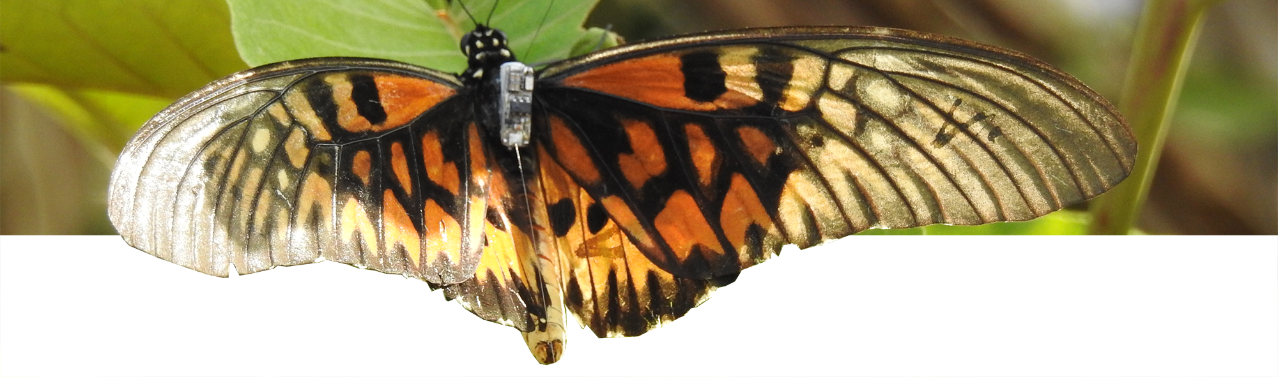
Questions
Contact:
info@telemetry.hu
www.telemetry.hu

